Slide 1


Slide 5
Color Sensing and Identification
Color sensor systems are increasingly being used in automated applications to detect automation errors and monitor quality at the speed of production line. They are used in assembly lines to identify and classify products by color. The objectives of their usage include to check the quality of products , to facilitate sorting and packaging , to assess the equality of products in storage , and to monitor waste products . Consequently, there is an abundance of color sensors and the choice is often application-driven . Low cost and simple color sensors are preferred over sophisticated solutions for less demanding applications where the top priority is cost and power consumption.
Color names can be used and conjure reasonably consistent perceptions. There have eleven basic color names that have been identified such as white, gray, black, red, yellow, green, blue, orange, purple, pink, and brown. Most or all colors can be described in terms of variations and combinations of these colors . Due to the fact that human color vision is accomplished in part by three different types of cone cells in the retina, it follows that three values are necessary and sufficient to define any color. Color theory describes that there are three values that can be thought of as coordinates of a point in three-dimensional space, giving rise to the concept of color space. Hue, saturation, luminance is one such color co-ordinate system, or color space.

Slide 6
Color Sorting
Bickman, et al described in the article about automated color-sorting using optical technology that has evolved from early designs intended to remove ceramic contaminants. The system configuration is similar to automated ceramic removal equipment, but color-sorting equipment used a different light source. Automated systems can generally be instructed to remove any one or a combination of the three glass colors. Industrial applications require some sort of automated visual processing and classification of items placed on a moving conveyor. Bozma and Yal-cin [14] state that items may be randomly positioned and oriented while moving on a conveyor. A camera located above the conveyor views the items orthographically. Boukouvalas et al [15] describes an integrated system developed for the detection of defects on color ceramic tiles and for the color grading of defect-free tiles. The integrated system developed under the ASSIST project (automatic system for surface inspection and sorting of tiles) is used for the detection of defects on color tiles and for the color grading of defect-free tiles. Many have proposed advanced solutions for the sorting of recyclable packaging towards process automation. Mattone et al [16] had explained about a technique for detecting and classifying objects. Most of the authors prefer to use 2D Vision techniques to separate the objects from the known belt background and to get some of their geometrical parameters.

Slide 7
TCS230 Color Sensor
The TCS230 is a programmable color sensing module equipped with GY-31 light-to frequency converter that combines configurable 8x8 silicon photodiode array as single monolithic CMOS integrated circuit . The output is a square wave (50 percentage duty cycle) with frequency directly proportional to light intensity (irradiance). The full scale output frequency can be scaled by one of three preset values via two control input pins. Digital inputs and digital output allow direct interface to a microcontroller or other logic circuitry. Output enable (OE) places the output in the highimpedance state for multiple unit sharing of a microcontroller input line. The light-to-frequency converter reads an 8 x 8 array of photodiodes. Sixteen photodiodes have blue filters, 16 photodiodes have green filters, 16 photodiodes have red filters, and 16 photodiodes are clear with no filters. The four types (colors) of photodiodes are inter-digitated to minimize the effect of non-uniformity of incident irradiance. All 16 photodiodes of the same color are connected in parallel and which type of photodiode the device uses during operation is pin-selectable. Photodiodes are 120 mm x 120 mm in size and are on 144-mm center.

Slide 8
Generalized Measurement System
COLOUR SENSOR
TCS230
ARDUINO
NANO
SERVO MOTORS
Primary Sensing
Element
Variable Conversion & Manipulation element
Data Transmission
OBJECTS ARE SORTED ACCORDING TO THEIR COLOURS
DATA PRESENTATION

Slide 9
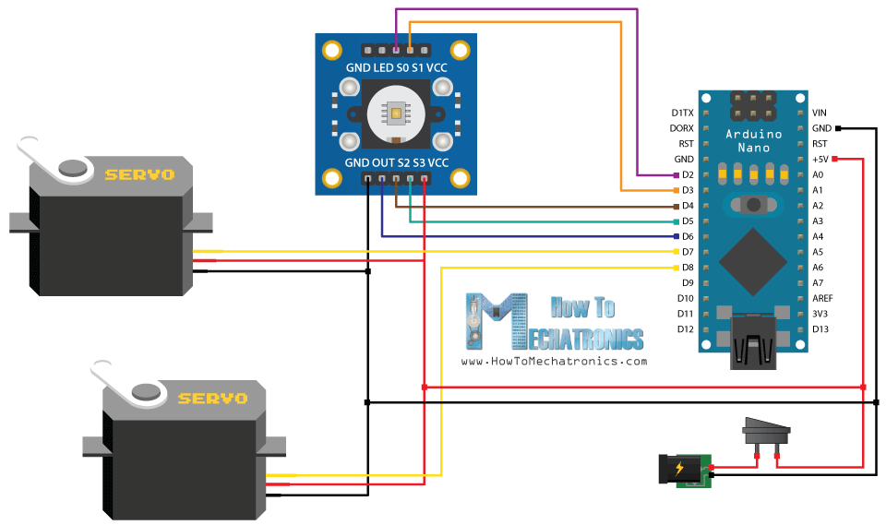

Slide 10
Applications :
We can add a load cell for measurement and control of weight of the product
We can also add a counter for counting the number of products
Speed of the system can be increased accounting to the speed of production
The system can be used as a quality controller by adding more sensors
Line following robo follows the same principle

Slide 11
THE
END
THANKS
FOR
WATCHING

